Slide 1

Design Aspects Turbo-machines Laboratory Turbo-machines
Hari Bahadur Dura
Lecturer
Institute of Engineering (IOE)
Tribhuvan University
November, 2018

Slide 2
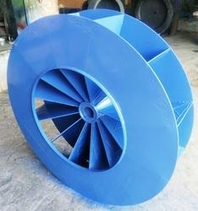
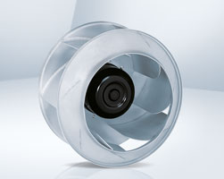
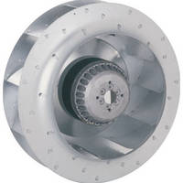
Centrifugal Impeller
There are three main categories of impeller type of impeller’s vane, which are used in the centrifugal pumps as:
Design of Impeller
Radial Vane
Backward Vanes
Forward Vanes

Slide 3
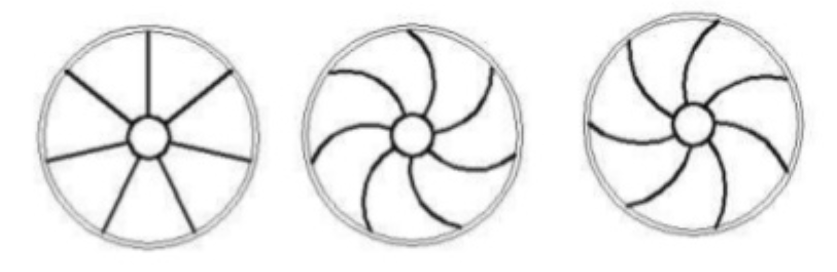
Centrifugal Impeller
There are three main categories of impeller type of impeller’s vane, which are used in the centrifugal pumps as:
Design of Impeller
Radial Vane
Backward Vanes
Forward Vanes

Slide 4
Backward Bladed Centrifugal Impeller
Design of Impeller
Velocity Triangle of backward bladed centrifugal impeller

Slide 5
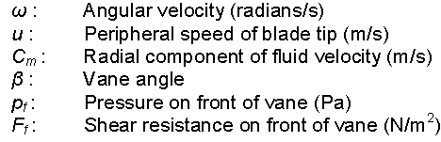
Backward Bladed Centrifugal Impeller
Design of Impeller
Velocity Triangle at Inlet and Outlet

Slide 6
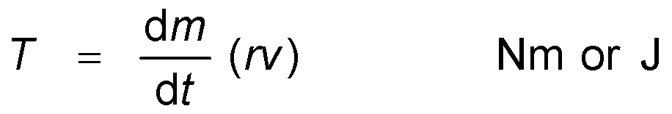
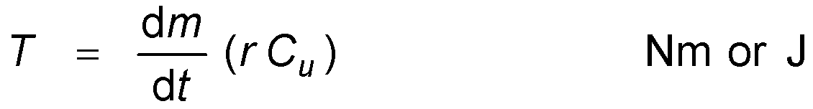
Backward Bladed Centrifugal Impeller
If a mass, m, rotates about an axis at a radius, r, and at a tangential velocity, v, then it has an angular momentum of mrv. Furthermore, if the mass is a fluid that is continuously being replaced then it becomes a mass flow, dm/dt, and a torque, T, must be maintained that is equal to the corresponding continuous rate of change of momentum
In the case of the centrifugal impeller depicted in Figure 10.3, the peripheral component of fluid velocity is C_{u}. Hence the torque becomes
Design of Impeller

Slide 7
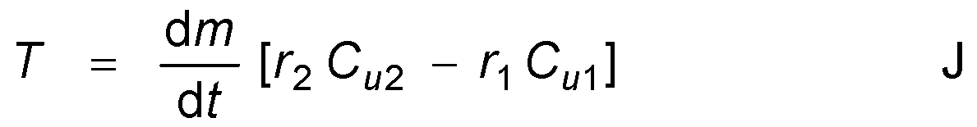
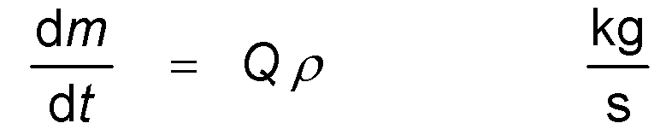
Backward Bladed Centrifugal Impeller
Consider the mass of fluid filling the space between two vanes and represented as abcd on Figure 10.3. At a moment, dt, later it has moved to position efgh. The element abfe leaving the impeller has mass dm and is equal to the mass of the element cdhg entering the impeller during the same time. The volume represented by abgh has effectively remained in the same position and has not, therefore, changed its angular momentum. The increase in angular momentum is that due to the elements abfe and cdhg. Then, from equation (10.5) applied across the inlet and outlet locations,
Design of Impeller

Slide 8
Backward Bladed Centrifugal Impeller
Giving
Now the power consumed by the impeller, P_{ow} is equal to the rate of doing mechanical work,
Design of Impeller

Slide 9
Backward Bladed Centrifugal Impeller
Design of Impeller

Slide 10
Backward Bladed Centrifugal Impeller
Design of Impeller

Slide 11
Backward Bladed Centrifugal Impeller
Design of Impeller

Slide 12
Backward Bladed Centrifugal Impeller
Design of Impeller

Slide 13
Backward Bladed Centrifugal Impeller
Design of Impeller

Slide 14
Backward Bladed Centrifugal Impeller
Design of Impeller

Slide 15
Backward Bladed Centrifugal Impeller
Design of Impeller

Slide 16
Backward Bladed Centrifugal Impeller
Design of Impeller

Slide 17
Backward Bladed Centrifugal Impeller
Design of Impeller

Slide 18
Backward Bladed Centrifugal Impeller
Design of Impeller

Slide 19
Backward Bladed Centrifugal Impeller
Design of Impeller

Slide 20
Backward Bladed Centrifugal Impeller
Design of Impeller

Slide 21
Assignment
First calculate based on the design parameters
Thickness of channel: 10cm
Inlet axial flow velocity = 2 m/s
Thickness of blade = 3 mm
Roll Number 1 – 16: Radial Impeller/8 blades
Radius of Eye = (30 + 0.1*x) cm
Radius of Outlet = (50 + 0.2*x) cm
Roll Number 17 – 32: Forward Curved Impeller/7 blades
Radius of Eye = (30 + 0.15*x) cm
Radius of Outlet = (50 + 0.15*x) cm
Roll Number 33 – 51: Backward Curved Impeller/7blades
Radius of Eye = (30 + 0.1*x) cm
Radius of Outlet = (50 + 0.1*x) cm
Note:
You can choose appropriate fillet radius in your CAD model.
You can choose blade angles as per your desires condition
Design of Impeller

Slide 22
Assignment
First calculate based on the design parameters
Use excel or MATLAB to draw performance chart (i.e. del P vs Flow Rate and Power vs Flow Rate) | Deadline:
Orthographic view of impeller in AutoCAD
Create 3D model of the Impeller in 3D software like CATIA or Solidworks
Use Ansys CFX or Ansys Fluent to simulate the impeller and verify the result with analytical result (i.e. performance chart)
Plot following plots
Velocity contour field
Pressure contour field
Streamlines
Files Required:
Analytical results in Excel or Matlab (.xls or .xlsx or .m format)
AutoCAD file (.dxf and .dwg) format of orthographic
3D CAD Model (.igs and .stp) format
Report (latex files compressed in .rar file format)
Ansys simulation project file (compressed in .rar file format
Design of Impeller

Slide 23
Assignment
Guidelines and Code of Conduct
If found plagiarism
Geometry and CAD files 20% of marks reduction
Report contents 30% addition reduction of marks
Simulation 20% reduction marks
Analytical result 10% reduction
Late Submission 5% for each day
Evaluation Scheme
Report 50% (Latex 10% + Contents 30% + Report Format 10%)
CAD File 10%
Ansys CFD File 20%
Excel or Matlab File 10%
To know more about plagiarism please refer to the following website:
https://www.plagiarism.org/
Example for plagiarism checker:
https://www.grammarly.com/plagiarism-checker
Design of Impeller

Slide 24
If you have any questions regarding design,
don’t hesitate to ask me
!!!

